Slide 1
Asynchronous Delegation and its Applications
George Dill
October 28, 2019
Notes:
Thanks you all for coming today. I’m excited to share with you the work that Prof. Eriksson and my colleagues in the bits lab have been doing for the last several months.
We submitted the recommendation paperwork to the department a few weeks back, and we had an optimistic schedule. So, between friends, I’d like to give this talk a new title.

Slide 2
Asynchronous Delegation and its Applications
Aspirations
George Dill
October 28, 2019
Notes:
But even without the application we were working on, I’m excited to present to you the promising breakthoughs we’ve been making with delegation.

Slide 3
Accomplishments (On our benchmark)
Asynchronous Delegation approaches meet or exceed the throughput achieved by this lab in other delegation designs.
Dedicated Asynchronous Delegation exceeds the throughput of synchronized, shared memory approaches when delegated data structures are cache resident.
Flat Dedicated Delegation performs comparably to synchronized, shared memory approaches when delegated data structures are in DRAM.

Slide 4
Agenda
Background
Shared Memory in Parallel Applications
Previous Delegation Designs
Asynchronous Delegation Design
Dedicated Asynchronous Delegation
Flat Asynchronous Delegation
Results on Microbenchmark

Slide 5
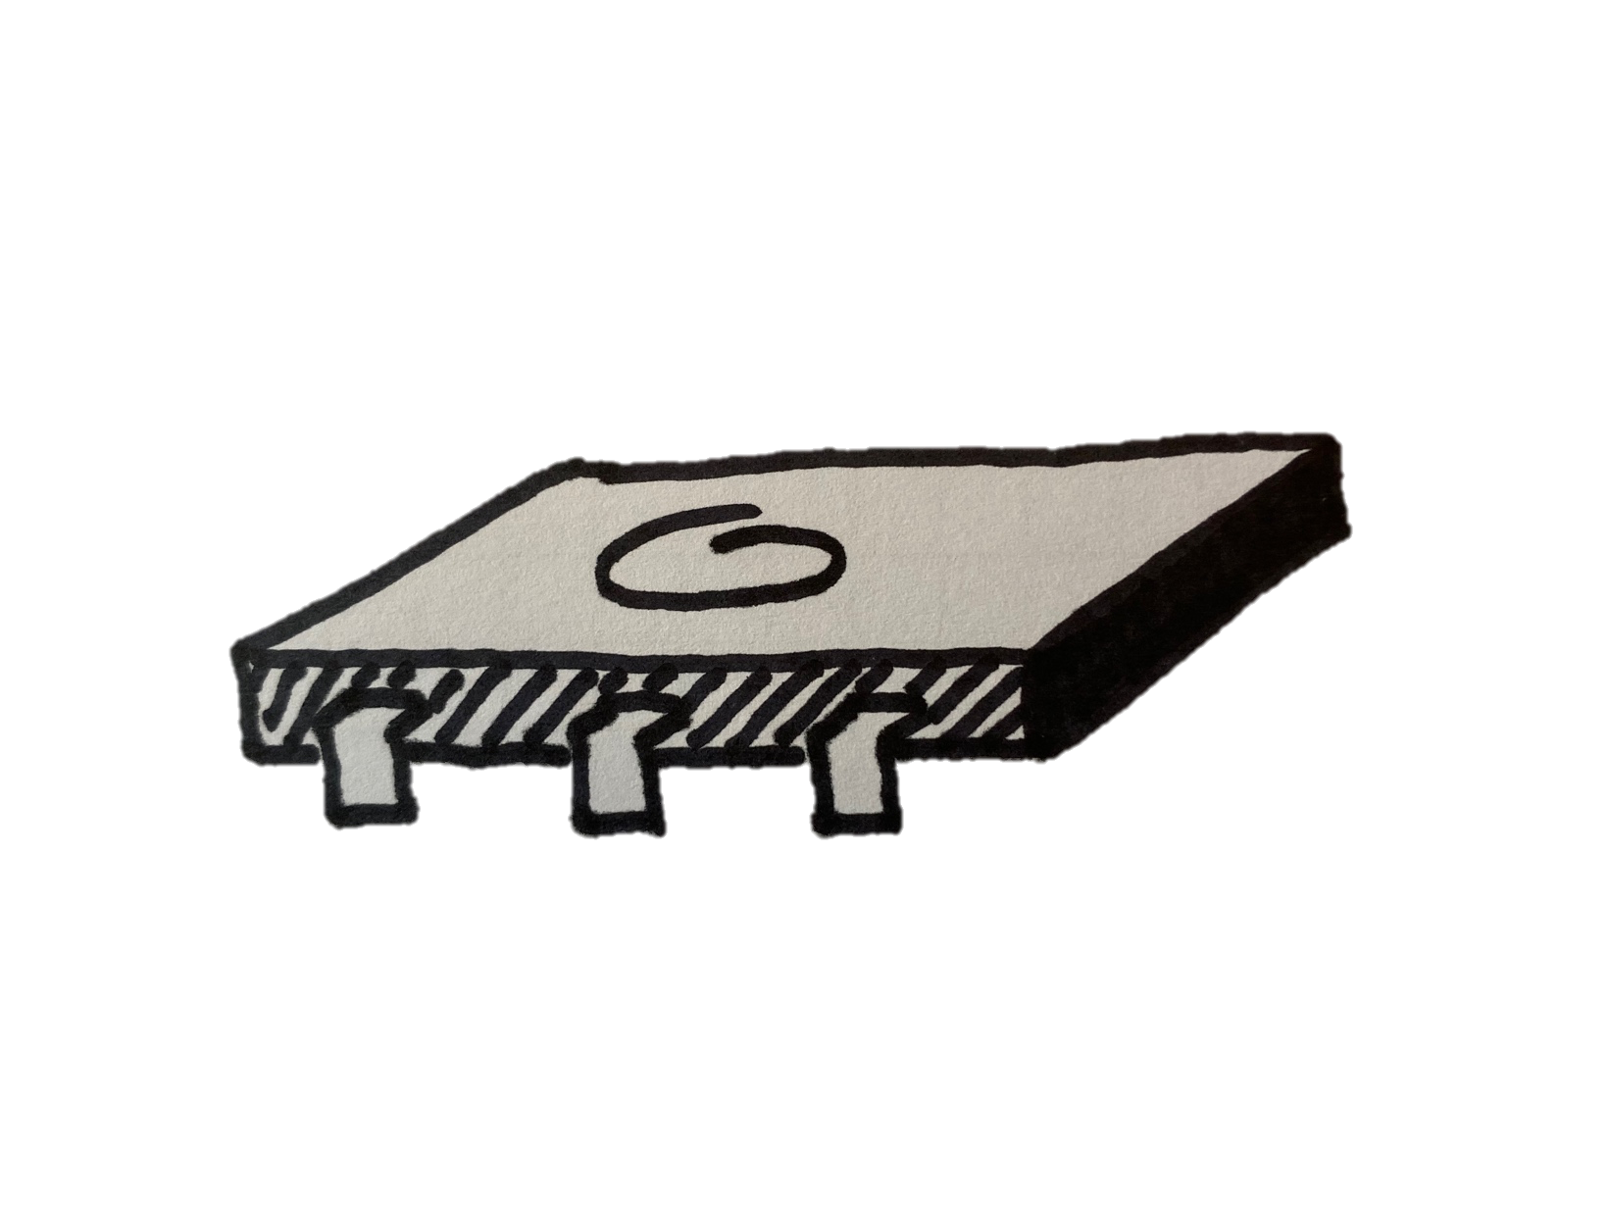
Background – Shared Memory
0
1
2
3
4
5
Notes:
In traditional parallel programming multiple processing units have domain over the entire shared data structure.

Slide 6
Background – Shared Memory
A
B
0
1
2
3
4
5
Notes:
Without synchronization, when multiple processors try to write to the same memory address we can get non-deterministic results.

Slide 7
Background – Synchronization By Locks
Read
Execute
Write
Read
Execute
Write
Read
Execute
Write
Read
Execute
Write
Read
Execute
Write
Read
Execute
Write
Notes:
The results are non deterministic because the timing of access is non deterministic. Threads writing at nearly the same time may overwrite each other’s output. Threads operating in sequence will produce the desired outcome.

Slide 8

Background – Synchronization By Locks
Read
Execute
Write
Read
Execute
Write
Read
Execute
Write
Read
Execute
Write
Read
Execute
Write
Read
Execute
Write
Notes:
We call this the race condition, because the outcome depends on which core gets access at what time.

Slide 9
Background – Shared Memory
A
B
0
1
2
3
4
5
Lock
0
1
2
3
4
5
Data
Notes:
Since the 60’s we’ve been solving this problem using locks. A lock is a signal to other processing units that a data structure is in use by another. While the lock is written other processors are excluded from the locked memory. Here’s an example. A and B are contending for the lock.

Slide 10
Background – Shared Memory
A
B
0
A
2
3
4
5
Lock
0
1
2
3
4
5
Data
Notes:
A gets control and makes its change to the data structure.

Slide 11
Background – Shared Memory
A
B
0
1
2
3
4
5
Lock
0
1
2
3
4
5
Data
Notes:
A releases the lock.

Slide 12
Background – Shared Memory
A
B
0
B
2
3
4
5
Lock
0
1
2
3
4
5
Data
Notes:
B obtains the lock and makes its change to the data structure.

Slide 13
Background – Shared Memory
A
B
0
1
2
3
4
5
Lock
0
1
2
3
4
5
Data
Notes:
The transaction is finished.

Slide 14
Background – Synchronization By Locks
Acquire
Read
Execute
Write
Release
Acquire
Read
Execute
Write
Release
Acquire
Read
Execute
Write
Release
Acquire
Read
Execute
Write
Release
Notes:
Synchronization by locking works because it serializes the read and write operations. Only one processing unit is operating on a data structure at a time. The downfall is that processing units spend time waiting to acquire the lock when the data structure is contended. In this case we have only 2 processing units contending for the lock. Should we have 3, 4, 5, 128 the wait to acquire the lock would grow proportionally.

Slide 15

Background – FFWD Style Delegation
Will you do x += 1 for me?
Sure, the result is 2.
Client
Server
Notes:
Reducing this wait is a motivation behind the work in our lab that we call delegation.

Slide 16
Background – Shared Memory
0
1
2
3
4
5
Notes:
Delegation, in the style developed by Jakob, Sepideh, and Nilanjana in FFWD involves sharding our shared data structure into units managed exclusively by single processing units that we call servers.

Slide 17
Background – Shared Memory
Client
Server
Server
0
1
2
3
4
5
Data
Notes:
In our three thread system we’ve split our data structure and assigned half of it to server 1, on the left. And half of it to server 2, on the right. Our third thread, in the top center will be executing some work.

Slide 18
Background – Shared Memory
Will you modify 1 for me?
Client
Server
Server
0
1
2
3
4
5
Data
Notes:
Our client thread needs modify something in position one. Its aware of which server thread has custody of that data structure. It delegates the operation on that data structure to the server in charge by passing a message.

Slide 19
Background – Shared Memory
Will you modify 1 for me?
Client
Server
Server
0
1
2
3
4
5
Data
Notes:
The server receives the message, and does the requested operation.

Slide 20
Background – Shared Memory
Client
Its done, here’s the result.
Server
Server
0
1
2
3
4
5
Data
Notes:
And acknowledges that the task is complete by sending the return result back to the client.

Slide 21
Background – FFWD Delegation Design
Request 0
Delegated Data Structure
Request 1
Client 0
Response 0
Server
Response 1
Client 1
Notes:
The messages are passed across arrays allocated for each client – server pair that we call request lines and response lines. Each request is a 64 B struct containing a function pointer, up to 6 variables, and a flag. Each response is a 16 B struct containing a return value and a matching flag. The system works as follows.

Slide 22
Background – FFWD Delegation Design
Request 0
Delegated Data Structure
Request 1
Client 0
Response 0
Server
Response 1
Client 1
Notes:
Client 0 and Client 1 want to make changes to server’s data structure at the same time. They both write a request to their unique request line on server.

Slide 23
Background – FFWD Delegation Design
Request 0
Delegated Data Structure
Request 1
Client 0
Response 0
Server
Response 1
Client 1
Notes:
Server is constantly polling its request lines, when it encounters a valid request.

Slide 24
Background – FFWD Delegation Design
Request 0
Delegated Data Structure
Request 1
Client 0
Response 0
Server
Response 1
Client 1
Notes:
It invokes the function.

Slide 25
Background – FFWD Delegation Design
Request 0
Delegated Data Structure
Request 1
Client 0
Response 0
Server
Response 1
Client 1
Notes:
And writes the return value back to the appropriate, unique response line for the client.

Slide 26
Background – FFWD Delegation Design
Request 0
Delegated Data Structure
Request 1
Client 0
Response 0
Server
Response 1
Client 1
Notes:
Client 0 receives its response, freeing the request and response lines for the next transaction. In the mean time the server has moved on to serving client 1’s request.

Slide 27
Background – FFWD Delegation Design
Request 0
Delegated Data Structure
Request 1
Client 0
Response 0
Server
Response 1
Client 1
Notes:
The function from the request is invoked.

Slide 28
Background – FFWD Delegation Design
Request 0
Delegated Data Structure
Request 1
Client 0
Response 0
Server
Response 1
Client 1
Notes:
And the response written out.

Slide 29
Background – FFWD Delegation Design
Request 0
Delegated Data Structure
Request 1
Client 0
Response 0
Server
Response 1
Client 1
Notes:
Client 1 has now received its response, the value in the data structure is deterministic because the only one processing unit, the server, has been reading and writing.

Slide 30
Background – FFWD API
Function | Description
ffwd_init() | Allocate request / response lines
launch_servers(num_servers) | Launch OS threads for the requested number of servers
thread_create(client_fun, param) | Launch OS threads running the client function specified
ffwd_exec(server, ret, fun, param) | Delegate function fun to server
shutdown() | Stop servers, free request / response lines
Notes:
The programming model is pretty simple. Initialize the request and response lines. Launch OS threads running the server function. Launch client functions using the POSIX threads like function. Within client threads delegate using ffwd_exec.
When you’re done, join server threads and free memory using shutdown.

Slide 31
Background - Benefits of Delegation
No contention for memory
Spatial locality of memory
On NUMA node allocation of data structures

Slide 32
Background – FFWD Delegation
Polling
Execution
Polling
Server
Generate Request
Waiting
Back to Work
Client
Time
Notes:
The downside is that clients still block while they are waiting on a response from the server. We refer to the time from request issuance to receipt of its response as request latency.
A client’s delegated request still ”waits in line,” but doesn’t experience the latency involved in gaining exclusive control of a data structure in the cache coherency / memory subsystem.

Slide 33
Background – FFWD API
Function | Description
ffwd_init() | Allocate request / response lines
fiber_manager_init() | Launch fiber managers on all system cores
launch_servers(num_servers) | Launch fibers running the server function
fiber_create(client_fun, param) | Launch a fiber running client_fun
ffwd_exec(server, ret, fun, param) | Delegate function fun to server
shutdown() | Stop servers, free request / response lines
Notes:
To get over the latency bottleneck of FFWD, Sepideh and Jakob developed Gepard. Which uses a library called libfiber to enable hardware threads to perform concurrent requests. The idea is that many, lightweight, cooperatively scheduled user space threads can run on a single processing unit. One thread can issue a request, and then yield to the next during its request latency period. The programmer does this by launching many more client threads, as fibers, than they did under FFWD. The fibers are handled by a fiber manager which performs a context switch after a request is written.

Slide 34
Background – Gepard Delegation
Polling
Execution
Polling
Execution
Server
Client
Generate Request
Off Core
Back to Work
Manager
Off Core
Off Core
Off Core
Client
Off Core
Generate Request
Off Core
Client
Time
Notes:
Here’s an example of an OS thread running with two client fibers. The first client generates a request, and then yields. The fiber manager switches to client 2, which generates a request and then yields. Client one is reinvoked and reads the response from the server.
In our trials with Gepard we found peak performance was usually around 64 fibers / thread. Gepard, however, has a lot of computational overhead in the fiber manager because it is trying to maintain the state of all these fibers running on a single thread.

Slide 35
Problem Statement
ffwd_exec(server, ret, fun, param)
Can we avoid the computational and memory
overhead of libfiber to generate more requests?
Notes:
Spoiler: The answer is the title of this presentation.

Slide 36
Asynchronous Delegation
Function | Description
ffwd_init() | Allocate request / response lines
launch_servers(num_servers) | Launch OS threads for the requested number of servers
thread_create(client_fun, param) | Launch OS threads running the client function specified
exec_async(server, cb, fun, param) | Delegate function fun to server, execute callback cb when response is detected
async_barrier() | Clear all outstanding requests before returning.
shutdown() | Stop servers, free request / response lines
Notes:
My contribution is a refactoring of the FFWD delegation library to support asynchronous delegation calls. The key is here (point) at exec_async() Instead of maintaining the state of the request, we invoke a callback function (if necessary) upon the detection of a response from the remote server. The API is simplified compared to Gepard because we no longer need the fiber library to enable our concurrent request to the server. There’s no more context switching between fibers, and the user doesn’t have to be aware of the mechanics of the fiber library to split the work.

Slide 37
Asynchronous Delegation – Comparison to Gepard
Queue 0
…
Request 0
…
…
Queue 32
Request 16
Response 0
…
Response 16
Client
Notes:
The changes to Gepard are all in the client code. Here’s how our best version of asynchronous delegation works.

Slide 38
Asynchronous Delegation – Comparison to Gepard
Queue 0
…
Request 0
…
…
Queue 32
Request 16
Response 0
…
Response 16
Client
Notes:
Clients, instead of issuing requests directly to the request line enqueue requests into a local reserve. The client can return to generating requests because it is no longer depends on the return value from the server to continue execution.

Slide 39
Asynchronous Delegation – Comparison to Gepard
Queue 0
…
Request 0
…
…
Queue 32
Request 16
Response 0
…
Response 16
Client
Notes:
So the continues generating requests. In the meantime the server is serving the requests already out on the request line.

Slide 40
Asynchronous Delegation – Comparison to Gepard
Queue 0
…
Request 0
…
…
Queue 32
Request 16
Response 0
…
Response 16
Client

Slide 41
Asynchronous Delegation – Comparison to Gepard
Queue 0
…
Request 0
…
…
Queue 32
Request 16
Response 0
…
Response 16
Client
Notes:
Now the reserve is full.

Slide 42
Asynchronous Delegation – Comparison to Gepard
Queue 0
…
Request 0
…
…
Queue 32
Request 16
Response 0
…
Response 16
Client
Notes:
The client invokes the callback on the responses it has received, and indicating that the request line is available.

Slide 43
Asynchronous Delegation – Comparison to Gepard
Queue 0
…
Request 0
…
…
Queue 32
Request 16
Response 0
…
Response 16
Client
Notes:
A request is taken from the reserve and written to the request line.

Slide 44
Asynchronous Delegation – Comparison to Gepard
Queue 0
…
Request 0
…
…
Queue 32
Request 16
Response 0
…
Response 16
Client

Slide 45
Asynchronous Delegation – Comparison to Gepard
Queue 0
…
Request 0
…
…
Queue 32
Request 16
Response 0
…
Response 16
Client

Slide 46
Asynchronous Dedicated Delegation
Execution
Polling
Execution
Server
Generate Requests
Handle Response
Write Requests
Generate Requests
Client
Time
Notes:
This design has no waiting!

Slide 47
Asynchronous Dedicated Delegation - Benchmark
Allocate (1) 64Byte variable per server
Vary the number of servers
Total core count sums to 56
Clients select a server at random and delegate an increment function continuously for 3 seconds
Count the total number of operations
Harmonic mean of 10 trials
16 Request Lines unless otherwise mentioned

Slide 48
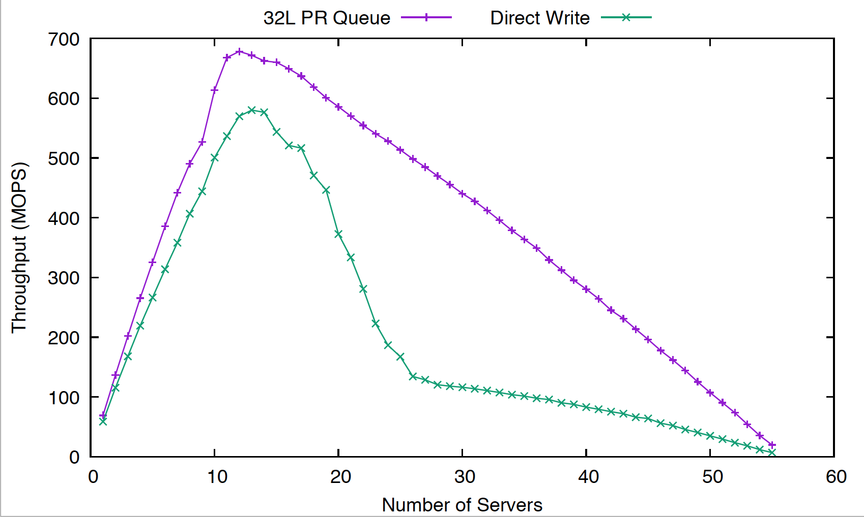
Asynchronous Dedicated Delegation – Why Hold a Request Reserve?
Notes:
Its faster! With the reserve, as I’ll show in the following slides, we don’t have a lot of waiting. In contrast, when we write request lines directly, if the request line isn’t available, there’s nowhere to store the recently generated request. The program collapses into polling the response line until it becomes free.

Slide 49
Asynchronous Dedicated Delegation – Request Reserve Implementation
Queue 0
Request 0
…
Queue 0
…
Request 0
…
…
Queue 0
Request 16
…
Queue 32
Request 0
…
…
Request 16
Queue 32
…
…
Request 16
Queue 32
Response 0
…
Response 0
Servers
Response 16
Client
…
Response 0
Response 16
…
Response 16
Notes:
The following conversation relies on an understanding of the implementation of the reserve. Each client maintains a fixed length queue for every server in the system. When any one of those queues reaches capacity, the client reads all responses on its response lines and executes the callback if provided. After that, there should be request lines available. We write as many responses possible out of the queues, and then we return to the client function.

Slide 50
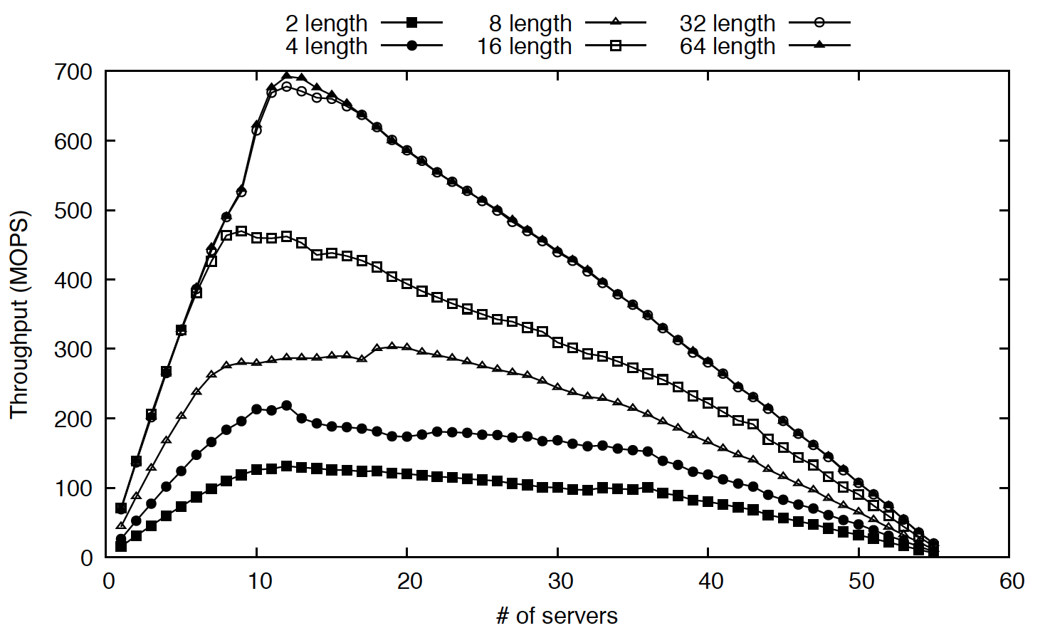
Asynchronous Dedicated Delegation – Pending Request Queue Length
Notes:
The length of these individual queues was an important design choice. As can be seen in this figure, the length of the queue increases throughput to a point. Then marginal gains from increasing the queue become negligible.

Slide 51
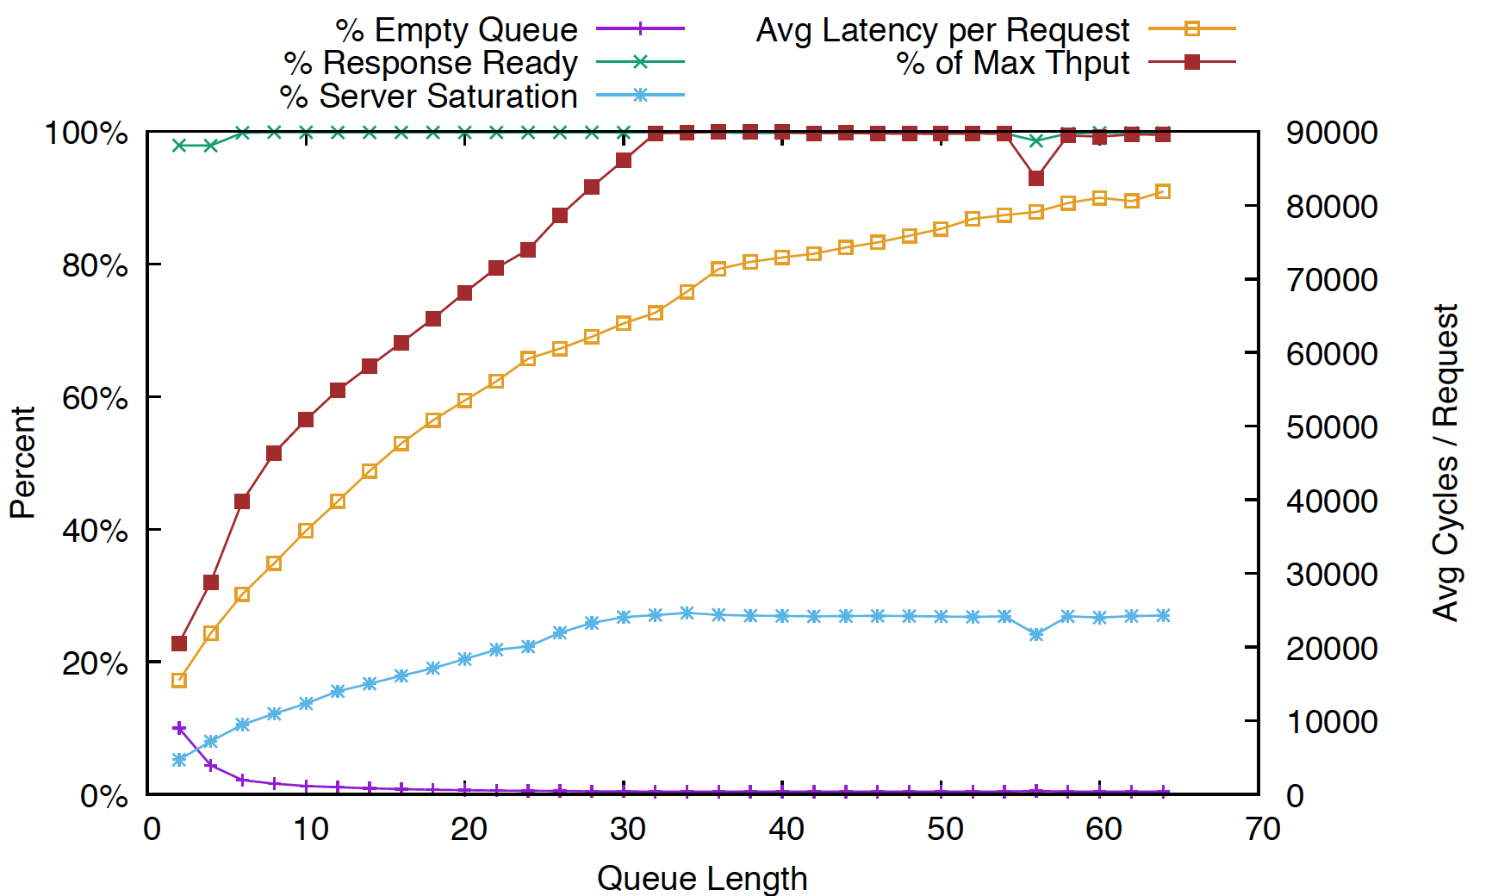
Asynchronous Dedicated Delegation – Pending Request Queue Length
16
Request
Lines

Slide 52
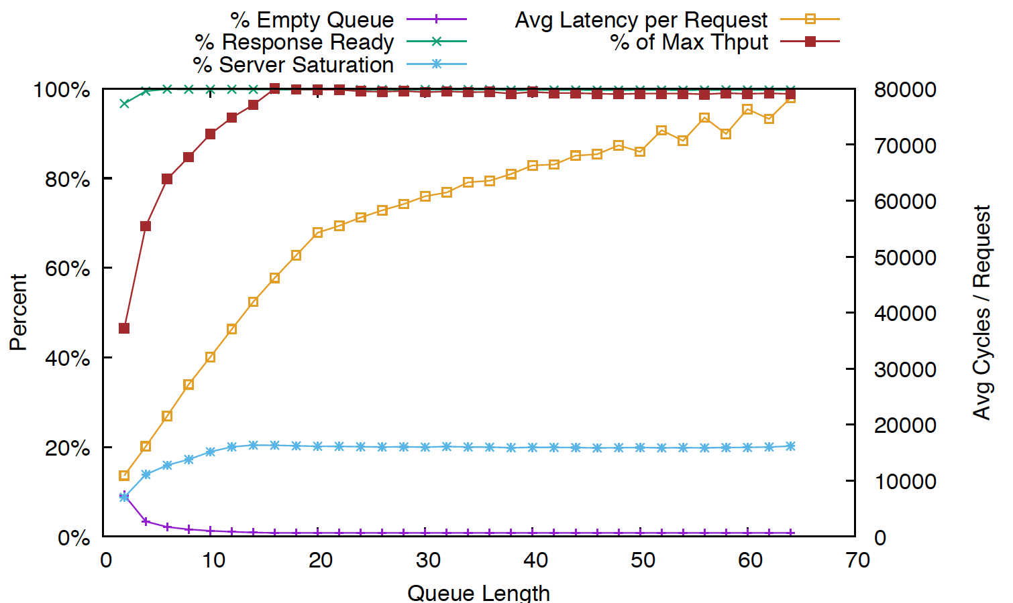
Asynchronous Dedicated Delegation – Pending Request Queue Length
8
Request
Lines

Slide 53
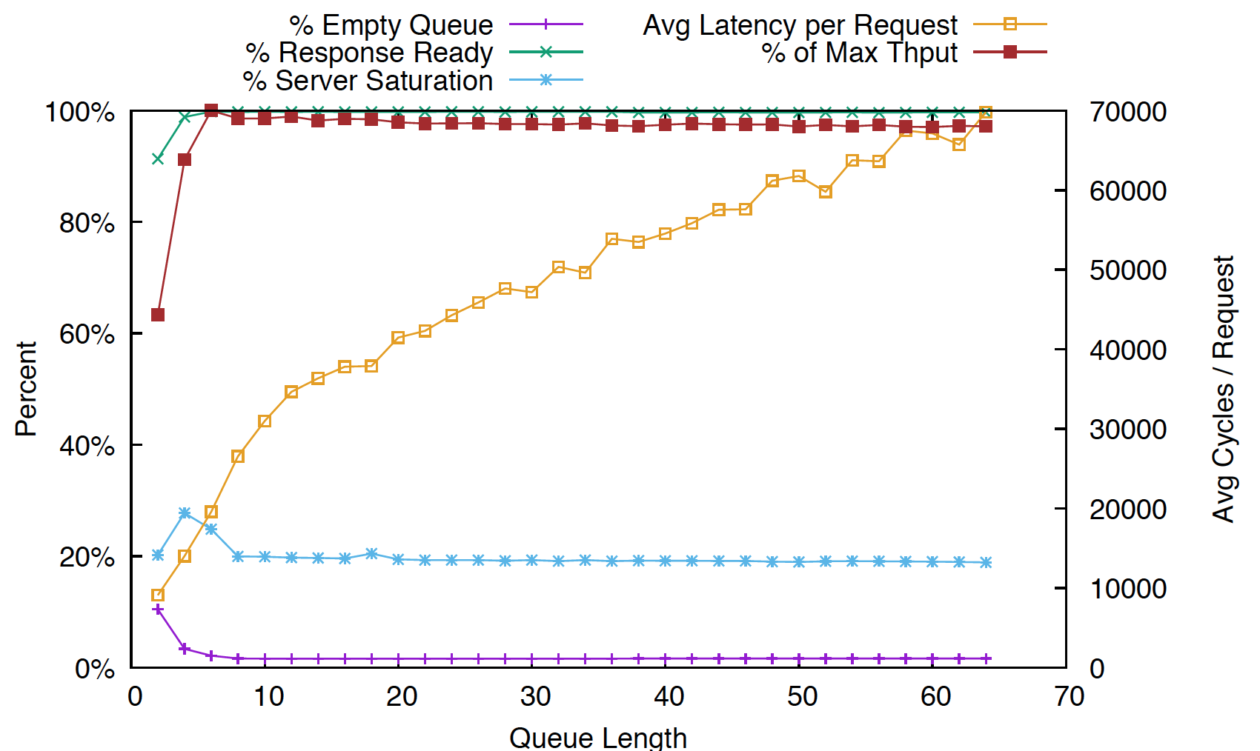
Asynchronous Dedicated Delegation – Pending Request Queue Length
4
Request
Lines

Slide 54
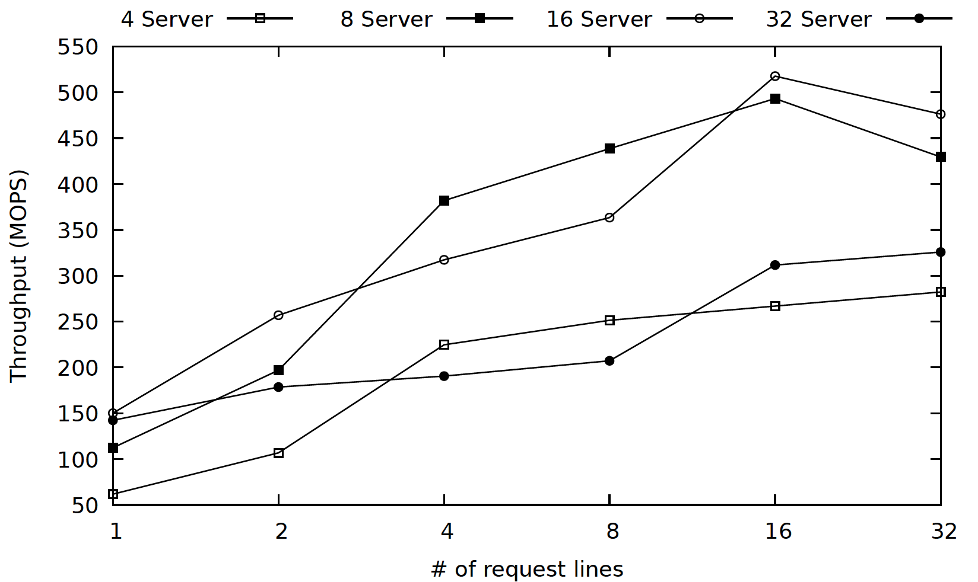
Asynchronous Dedicated Delegation – Number of Request Lines
Notes:
The number of request lines is also an important parameter. On our machine we measured that 16 was a good number.

Slide 55
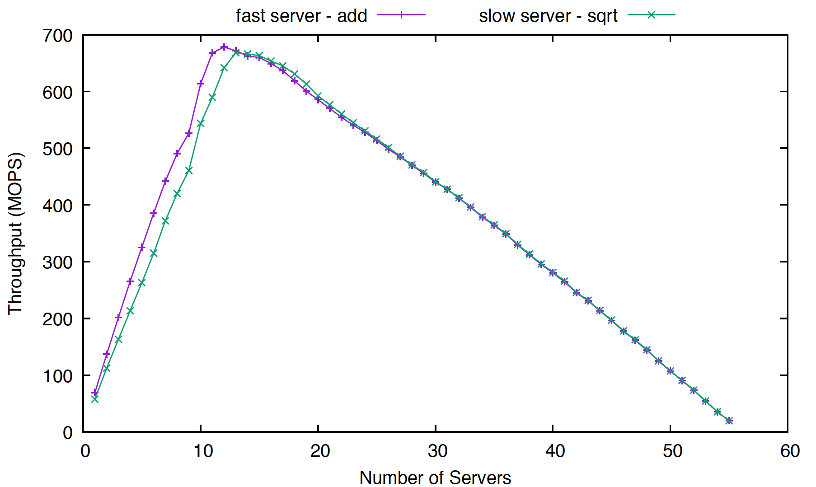
Asynchronous Dedicated Delegation – Client and Server Production Rates
Notes:
Before we leave the section on dedicated delegation, its important to note that the balance of clients and servers is an important, user defined parameter. In this experiment we change the delegated function to something slower – a sqrt rather than an increment in the delegated function. The peak is an equilibrium point between the server consumption rate, and the client production rate. If the server consumption rate slows, more servers will be needed to make up for the production rate of the clients, and the peak moves right. Programmers delegating more complicated functions should expect to use more server threads.

Slide 56

Notes:
Ideally, we’d like for our delegation system to find the equilibrium point on its own, without tuning by the programmer. Its not 100% yet, but I’d like to share with you the best that I’ve accomplished thus far.

Slide 57
Asynchronous Flat Delegation –Implementation
Queue 0
Request 0
…
Queue 0
…
Request 0
…
…
Queue 0
Request 16
…
Queue 32
Request 0
…
…
Request 16
Queue 32
…
…
Request 16
Queue 32
Response 0
…
Response 0
Response 16
Client
…
Response 0
Response 16
…
Response 16
Notes:
Here’s an asynchronous flat delegation thread offloading its request to three others.

Slide 58
Asynchronous Flat Delegation –Implementation
Queue 0
Request 0
…
Queue 0
…
Request 0
…
…
Queue 0
Request 16
…
Queue 32
Request 0
…
…
Request 16
Queue 32
…
…
Request 16
Queue 32
Response 0
…
Response 0
Response 16
Client
…
Response 0
Response 16
…
Response 16
Notes:
It generates requests and places them in its local queues.

Slide 59
Asynchronous Flat Delegation –Implementation
Queue 0
Request 0
…
Queue 0
…
Request 0
…
…
Queue 0
Request 16
…
Queue 32
Request 0
…
…
Request 16
Queue 32
…
…
Request 16
Queue 32
Response 0
…
Response 0
Response 16
Client
…
Response 0
Response 16
…
Response 16
Notes:
In the mean time, remote threads are writing responses to this thread’s response lines.

Slide 60
Asynchronous Flat Delegation –Implementation
Queue 0
Request 0
…
Queue 0
…
Request 0
…
…
Queue 0
Request 16
…
Queue 32
Request 0
…
…
Request 16
Queue 32
…
…
Request 16
Queue 32
Response 0
…
Response 0
Response 16
Client
…
Response 0
Response 16
…
Response 16

Slide 61
Asynchronous Flat Delegation –Implementation
Queue 0
Request 0
…
Queue 0
…
Request 0
…
…
Queue 0
Request 16
…
Queue 32
Request 0
…
…
Request 16
Queue 32
…
…
Request 16
Queue 32
Response 0
…
Response 0
Response 16
Client
…
Response 0
Response 16
…
Response 16
Notes:
A queue has filled. Now its time to read response lines and write requests.

Slide 62
Asynchronous Flat Delegation –Implementation
Queue 0
Request 0
…
Queue 0
…
Request 0
…
…
Queue 0
Request 16
…
Queue 32
Request 0
…
…
Request 16
Queue 32
…
…
Request 16
Queue 32
Response 0
…
Response 0
Response 16
Client
…
Response 0
Response 16
…
Response 16
Notes:
Request lines are read.

Slide 63
Asynchronous Flat Delegation –Implementation
Queue 0
Request 0
…
Queue 0
…
Request 0
…
…
Queue 0
Request 16
…
Queue 32
Request 0
…
…
Request 16
Queue 32
…
…
Request 16
Queue 32
Response 0
…
Response 0
Response 16
Client
…
Response 0
Response 16
…
Response 16
Notes:
And requests are written out.

Slide 64
Asynchronous Flat Delegation –Implementation
Request 0
…
Request 16
Queue 0
Request 0
…
…
Queue 0
…
Request 16
…
Queue 0
Queue 32
Request 0
…
…
Queue 32
…
…
Request 16
Queue 32
Server
Response 0
…
Response 16

Slide 65
Asynchronous Flat Delegation –Implementation
Request 0
…
Request 16
Queue 0
Request 0
…
…
Queue 0
…
Request 16
…
Queue 0
Queue 32
Request 0
…
…
Queue 32
…
…
Request 16
Queue 32
Server
Response 0
…
Response 16

Slide 66
Asynchronous Flat Delegation –Implementation
Queue 0
Request 0
…
Queue 0
…
Request 0
…
…
Queue 0
Request 16
…
Queue 32
Request 0
…
…
Request 16
Queue 32
…
…
Request 16
Queue 32
Response 0
…
Response 0
Response 16
Client
…
Response 0
Response 16
…
Response 16

Slide 67
Asynchronous Flat Delegation – Permutations
Pending Request Reserve
Direct Request Line Write
Serve when blocked
Fast path
Bound by fixed number of invocations
Doorbell
Notes:
As you’ll see in the figures ahead, the request reserve still offers the best throughput. However, the direct request line write gave us more granularity on when to invoke the server function.

Slide 68
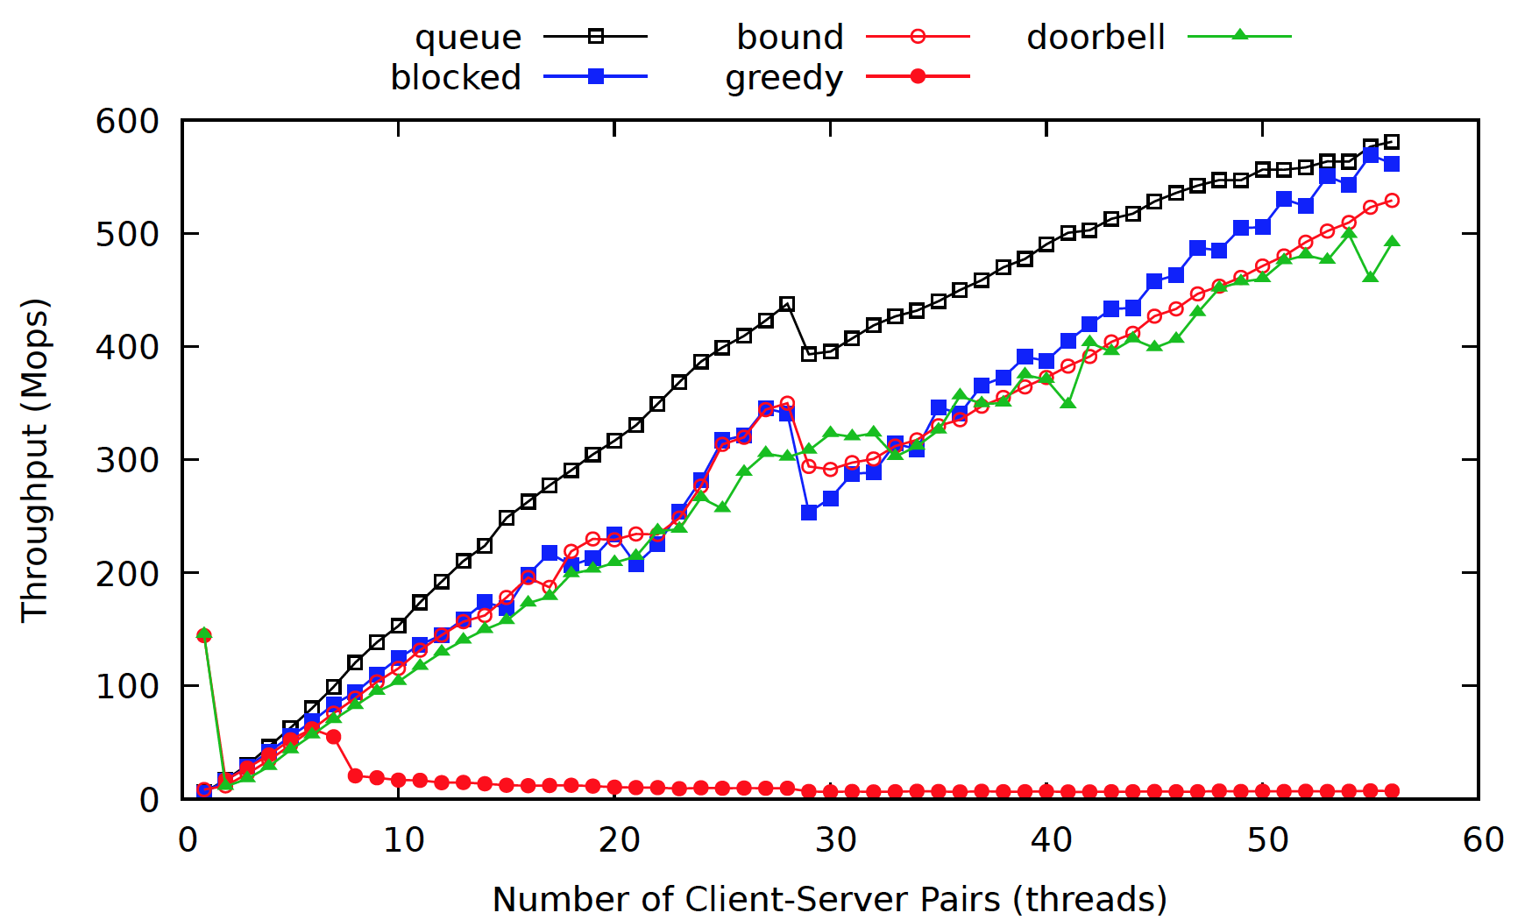
Asynchronous Flat Delegation – Results
Notes:
Explain what the scheduling strategy for each line is.

Slide 69
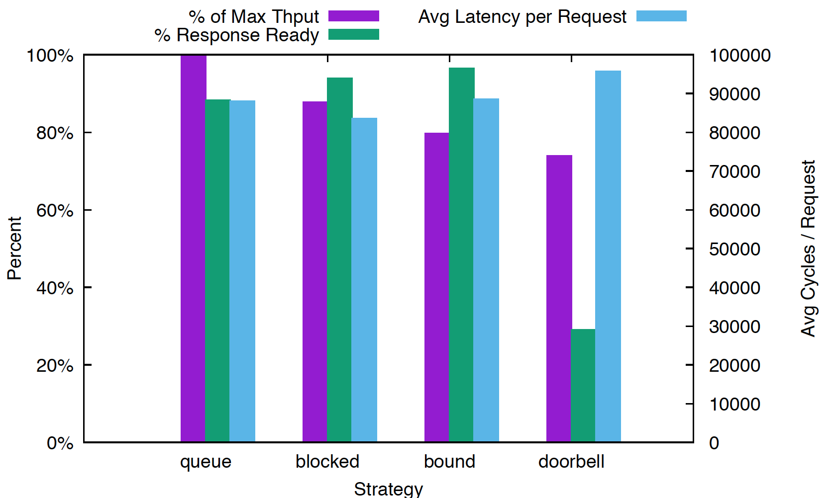
Asynchronous Flat Delegation - Latency
28 Client
Server
Pairs
Notes:
This suggests to me that queue may be stopping more often, since fewer requests are ready when polled.

Slide 70
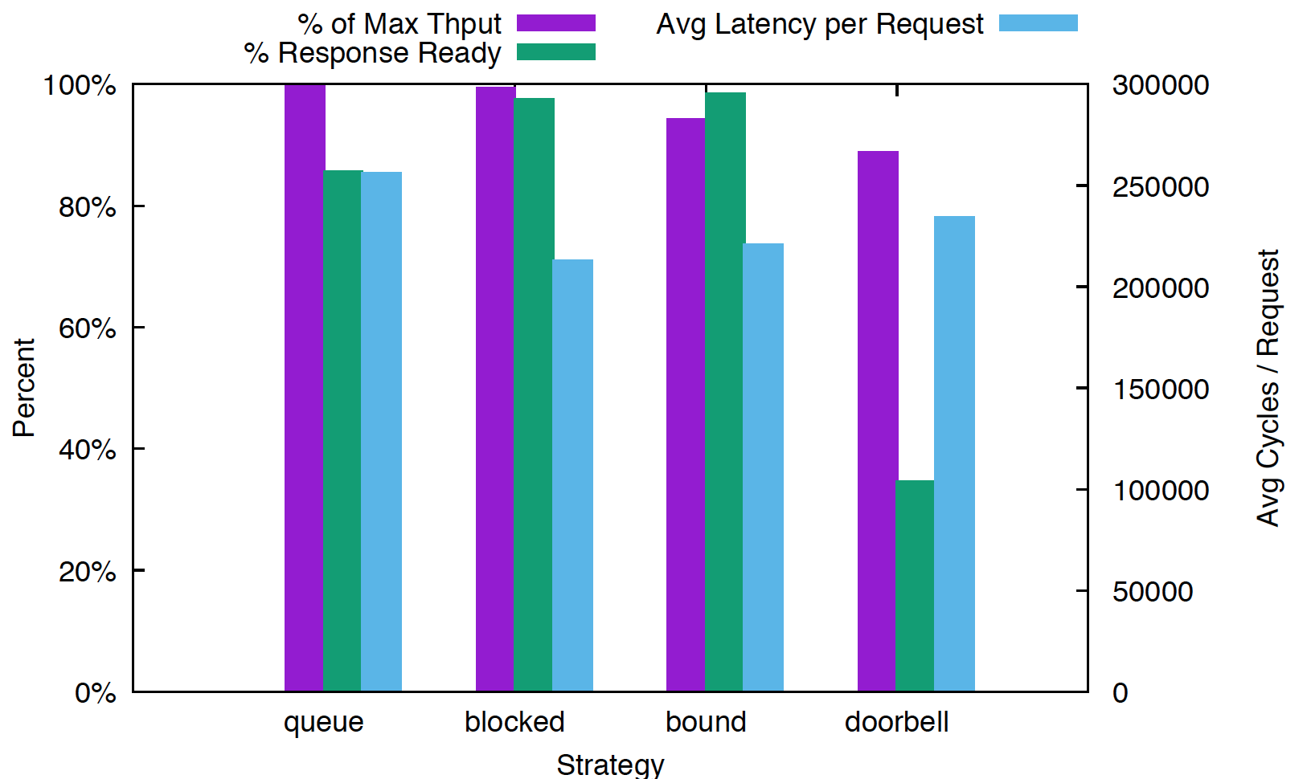
Asynchronous Flat Delegation - Latency
56 Client
Server
Pairs

Slide 71
Results of Microbenchmark
Quads Machines
Intel Skylake (2 ea) 14 core processors for 56 threads
32 KB L1, 1024KB L2 on-core cache
19,712 KB L3 cache per processor
97613732 kB DRAM

Slide 72
Results of Microbenchmark
3 second run time
10 trials
Delegation
Client selects variable at random and delegates an increment function
64 B variables distributed evenly among delegation servers
Allocated as a NUMA-aware 2-d array
Synchronized
Allocated as an array using malloc()
All 56 threads select a variable at random and increment
Uses POSIX mutex and spin lock
Atomic is gcc built in fetch and add.

Slide 73
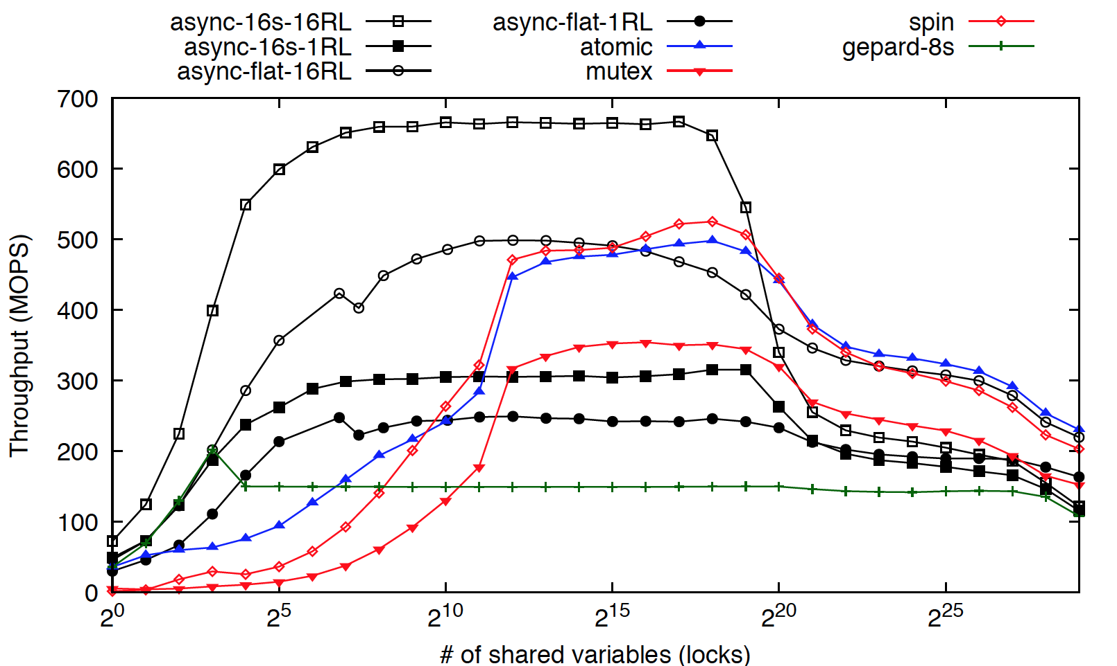
Results
Notes:
Explain the chart – x axis is the number of shared variables. Y axis is throughput in MOPS. Black lines are the outcomes of this research paper.
Lets highlight the exciting news. Our delegation approaches maintain supremacy in throughput when variables are highly contended.
Our asynchronous approaches excel, even as we get out of the range of high likelihood of contention.
We see a collapse in performance around 2^18 shared variables, which I’d like to address on the next chart.

Slide 74
Results
Notes:
This is output from a spreadsheet I put together that tracked the overhead of FFWD based on the numbers of clients and servers in the system. What we show on the graph is the probability that a variable selected at random by the client function will be resident in the server’s on-core cache. Let’s take a close look at when the probability of L3 cache residency rises. It corresponds with our initial decrease in performance. We see that decrease in performance level out as dram access become a higher percentage of reads.

Slide 75
Results
Notes:
We see that as the number of shared variables increases, the likelihood of any given operation is DRAM resident approaches 1. Dedicated approaches get bottlenecked by the number of threads making concurrent accesses. Flat delegation, however, has 56 threads making accesses to DRAM.
This gives us some motivation to keep exploring the potential of delegation in this region, because we still have a major advantage over the locking approaches, which we are performing comparably to in this range.

Slide 76
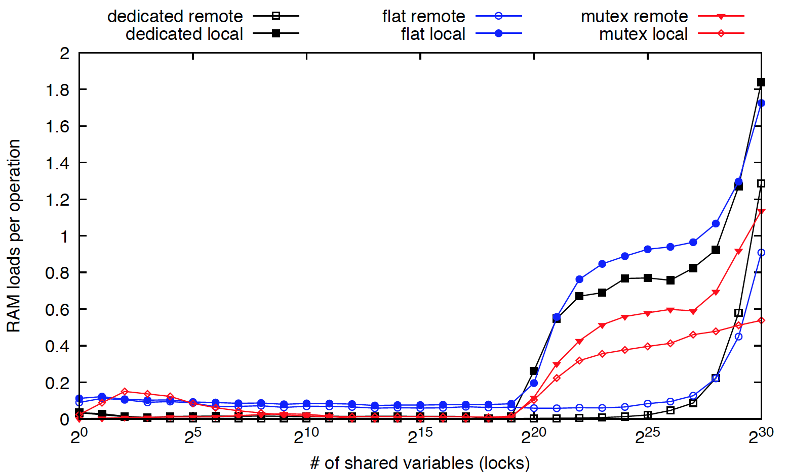
Results
Notes:
This has to do with the NUMA advantage. Locking approaches have a 1:NUMA NODES chance of getting a local access. This is evident in the mutex lock shown. In the mean while, our delegation approaches make nearly all their accesses with NUMA local ram.
Which brings me just about to the end. I think that the next steps for this project are to run some varied benchmarks to confirm the results we’ve seen with fetch and add. I’d also like to see us refactor a production application, like jellyfish, to work with our asynchronous versions and see if we can have a noticeable, positive, impact on performance.
Thanks for listening – I’d like to entertain any questions from the audience.

